Slide 1
The Work and Wealth debate
Hai-Yen Nguyen
Benson Yan
Alex Iacob

Slide 2
Overview
Introduction
Pros - In favor of the debate
Cons - Against the debate
Jury
Conclusion

Slide 3
Introduction
There exists a multinational company that has an office located in California and Bangalore, India
There are two employees that hold the same positions in the company and are the same age.
The employee at the California office makes $65,000 a year in salary and benefits
The employee at the Bangalore office makes $15,000 a year in salary and benefits
Is this ethically sound?

Slide 4
Pro - It is unethical to pay the people the same salary in different regions for the same job

Slide 5
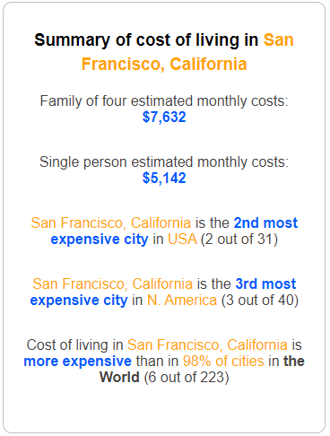
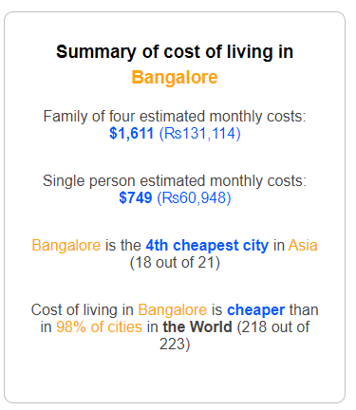
Differences in costs of living

Slide 6
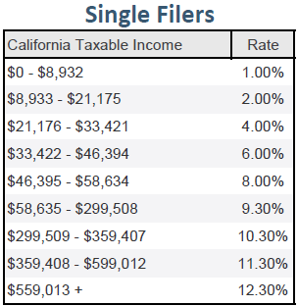
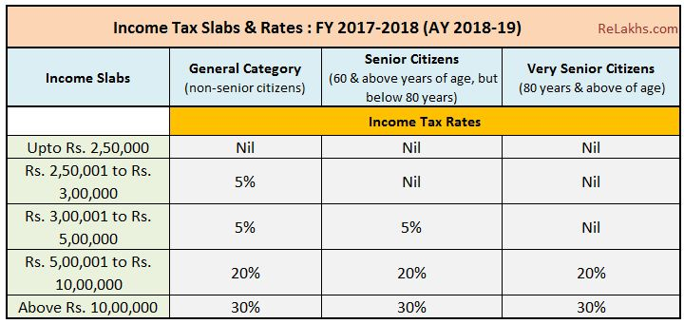
Differences in tax rates
up to $3072
$3073 - $3687
$3688 - $6145
$6146 - $12291
above $12292

Slide 7
Differences in job responsibilities
Even though two people have the same job title, they may have different day-to-day responsibilities in different offices
Each office is given different taskings, varying in difficulty
An office with a stronger group of employees would be given a more difficult tasking
A more difficult tasking will lead to higher pay among the employees

Slide 8
Con- It is ethical to pay the people the same salary regardless of different regions

Slide 9

Same job titles from the same company
Salary is directly linked to the company’s success
Employees drive the business forward
Income plays the crucial role in employee’s stability is so many ways
Income is the motivation to the employees for putting in the work
This directly impacts their productivity
So two employees from the same company where they share the same success… plus sharing the same job titles and work culture, they should be paid the same

Slide 10

Background Equality
One might argue that two employees could graduate from different institute and bring different skill sets to their own package.
However, regarding their background, both employees were hired from the same company, undergoing the same process of multi-rounds of interview. Both employees achieved to show performance to level with the company standards.
So they should be shared the same compensation

Slide 11
Jury - The ideal ethical argument

Slide 12


Jury -Unethical to pay the same rate to all employees
Discussion remains for potential two employees are working on different team, projects. Hence share different responsibilities although share the same job titles
Every person will have a different skill set even though they could have the same job title
There are highly differing tax rates and costs of living in each of the possible regions.
The exact same salary will be taxed differently and each person will take home far different amounts of money
Moreover, each employee comes with their own package of skill sets. Some might be have more past experiences and become more valuable assets to the company and its success, regarding the region they work in

Slide 13
https://www.expatistan.com/cost-of-living/san-francisco
https://www.expatistan.com/cost-of-living/bangalore?currency=USD
https://www.relakhs.com/latest-income-tax-slab-rates-for-fy-2017-18/
Sources

